Slide 1
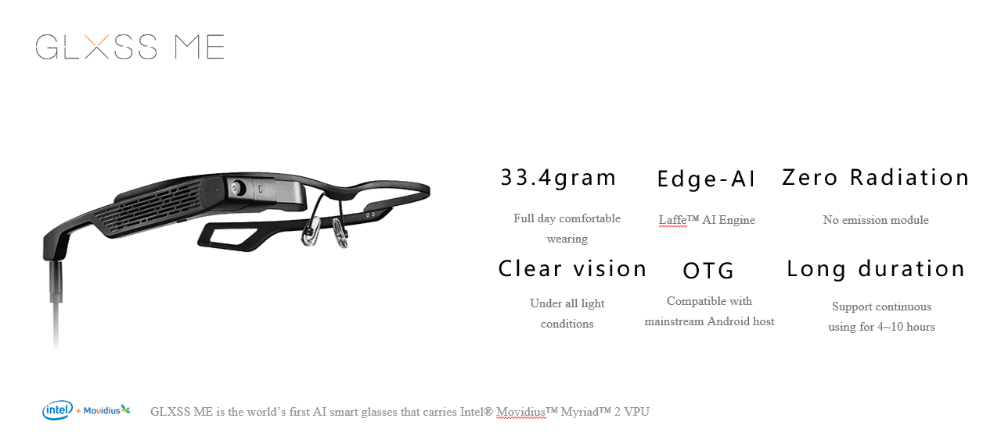

Slide 2
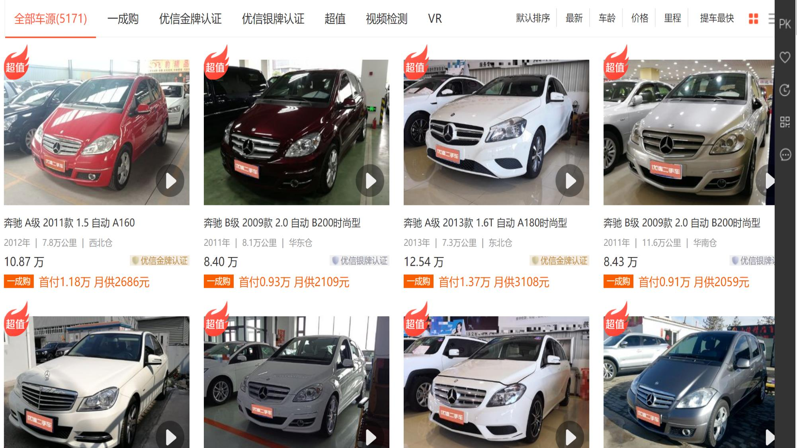

The BIGGEST AR Glass single contract worldwide
4,500 GLXSS ME glasses purchased by www.xin.com, the biggest 2nd hand car e-trading platform (listed on NASDAQ)
Offline first perspective video recording with state-of-art video marking function
Boosting sales by video publishing
Car inspection SOP reminder embedded
Behavior supervision of car inspectors

